Slide 1
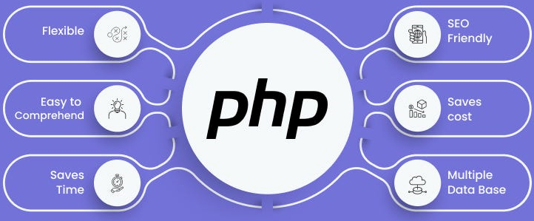

Slide 2
About today…
MySQL
Intro to MySQL
Connecting with PHP

Slide 3
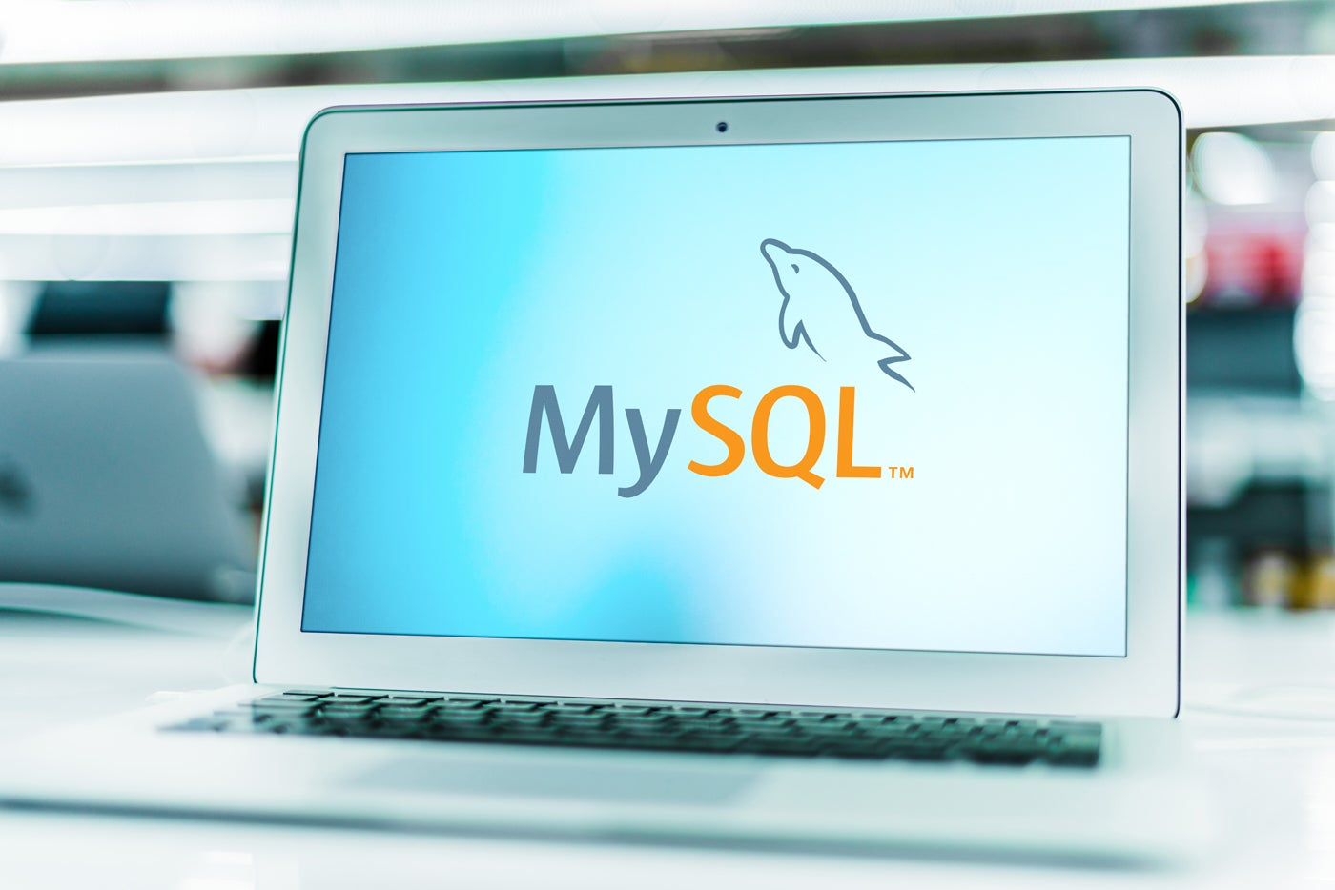

Slide 4


MySQL Databases
Definition
MySQL is a powerful and popular open-source relational database management
system
Usage
Store data
Manage data
Retrieve data
Importance
Plays a crucial role in many web applications,
allowing them to store and access information efficiently

Slide 5
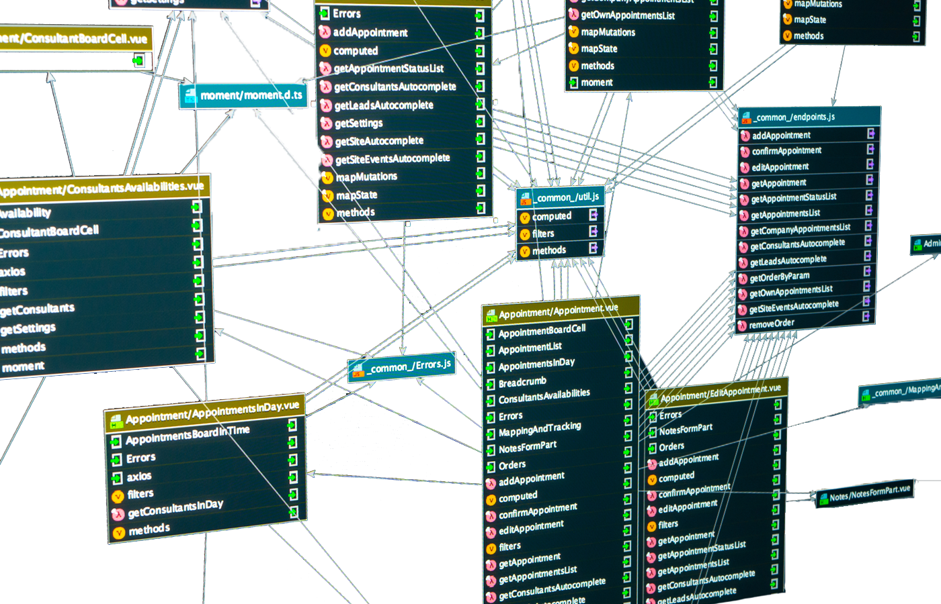
Understanding Relational
Databases
Relational databases organize data into tables
Each table consists of rows (records) and columns (fields)
Rows represent individual data entries
Columns define the specific attributes of each record
Tables are linked through relationships, ensuring data consistency

Slide 6

Benefits of Using MySQL
Open-source and free to use
Powerful and scalable
Reliable and secure
Supports complex queries
Widely used and well-documented

Slide 7

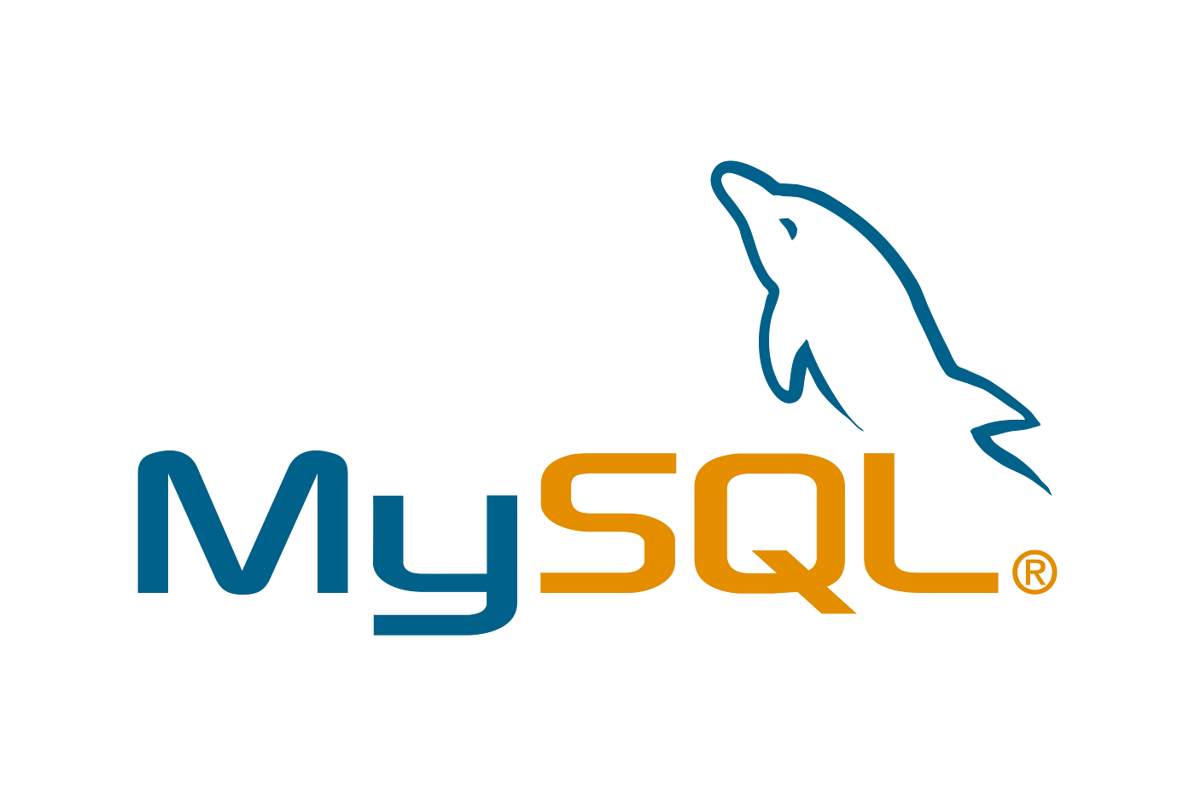


WAMP Server MySQL

Slide 8

Access phpMyAdmin
To access phpMyAdmin for managing MySQL databases, click on the WampServer icon in the system tray, then navigate to phpMyAdmin under the "Tools" menu
Alternatively, you can access phpMyAdmin directly by entering http://localhost/phpmyadmin/ in your web browser.
Use your credentials to log in (default username: root, password: blank)

Slide 9
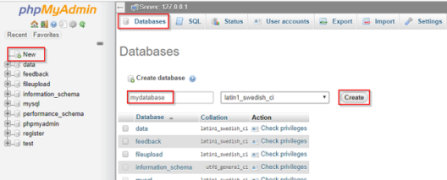
Creating a MySQL Database
In phpMyAdmin, click on the "New" button
Give the name of database to create it

Slide 10
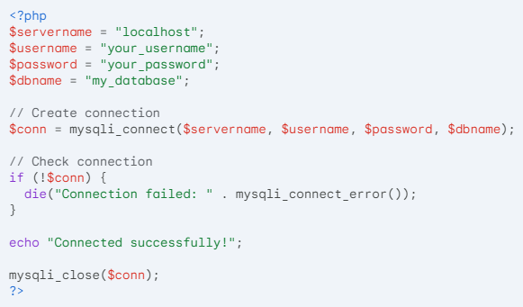
Connecting PHP with MySQL

Slide 11


Slide 12

Which function is used to establish a connection to a MySQL database in PHP?
How to close connection with MySQL database?
Which web interface is used to provide access to MySQL in WAMP?

Slide 13

Task 1
Connecting php to your MySQL database

